Slide 1
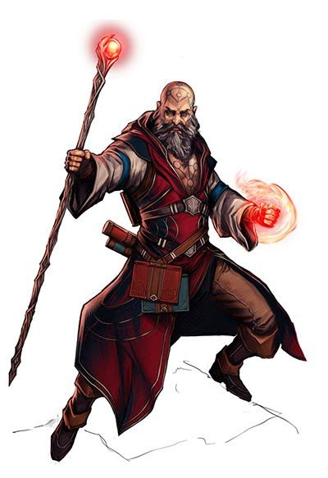
Unknown Realm

Slide 2
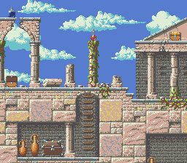
CC3-1E Unknown Realm Buclay, Chrysler Allaine Castro, Zedrick
Dago, Hooly Daluria, Elvin Jay Matso, Rashid

Slide 3

Project Description

Slide 4

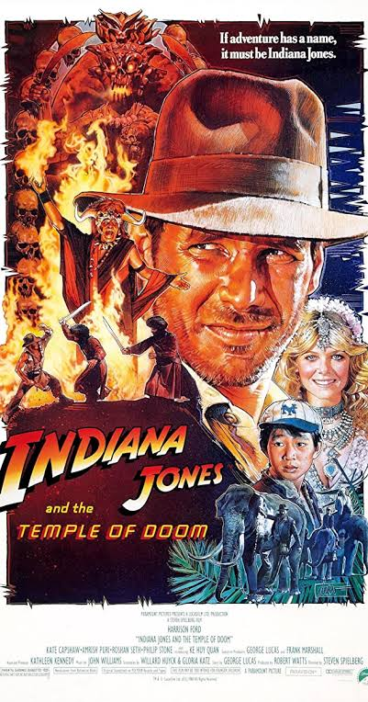
Story and Concept Based on :
Indiana Jones
I1936, American archaeologist Indiana Jones braves an ancient booby-trapped temple in Peru to retrieve a golden idol. After superating various challenges, including traitorous guides, he is confronted by rival archaeologist René Belloq and the indigenous Hovito people.

Slide 5
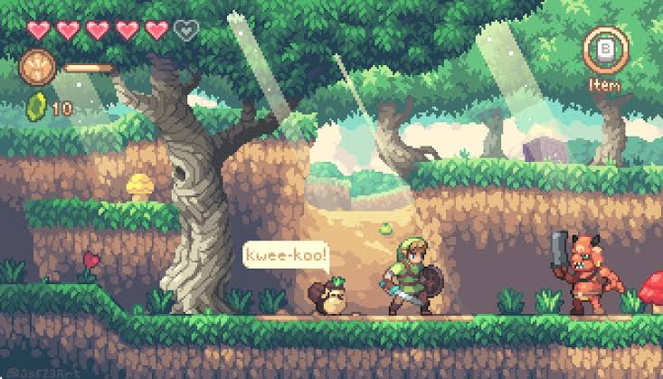
Sky sword
Algorithm and Game play based on :
Sky sword is an adventure slash and dice game. Where you choose a hero to discover and rescue.

Slide 6
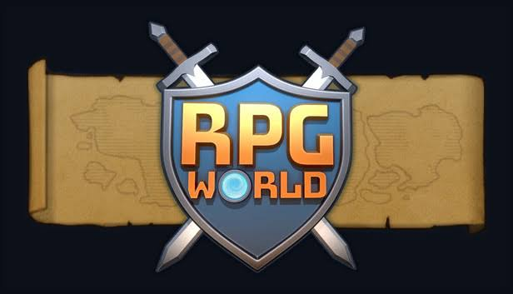
RPG
A role-playing game is a game in which players assume the roles of characters in a fictional setting. Players take responsibility for acting out these roles

Slide 7
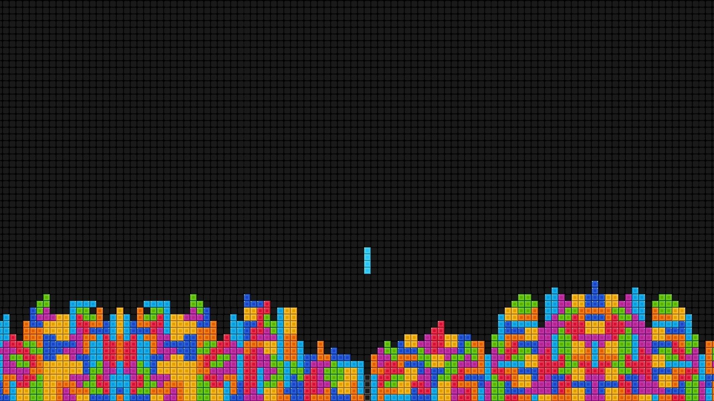
Pixel art games
Pixel art is a form of digital art, created through the use of software, where images are edited on the pixel level. The aesthetic for this kind of graphics comes from 8-bit and 16-bit computers and video game consoles, in addition to other limited systems such as graphing calculators.

Slide 8
II. GAME DESCRIPTION

Slide 9
About a hundred years ago when magicians exist there was once this magician that wants to go back in his home, he was lost in a realm that is unknown when he was training his power, when he was experimenting his power. Now, he wants your help to overcome also the unknown creatures in this realm and to access the portal in the final level to go back to his home.

Slide 10
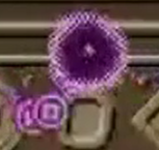
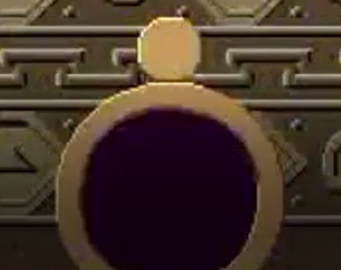
This is the boss that the magician will need to defeat in order to go home
This is the portal that the magician needs to go back to his home

Slide 11
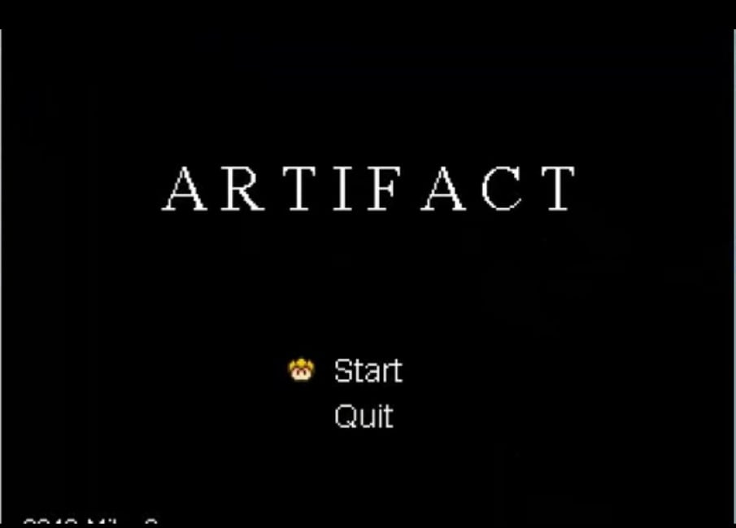
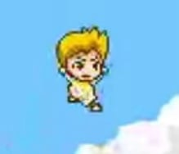
This character was the one to finish the dungeon and to eliminate the boss at the end

Slide 12
III. Gameplay

Slide 13
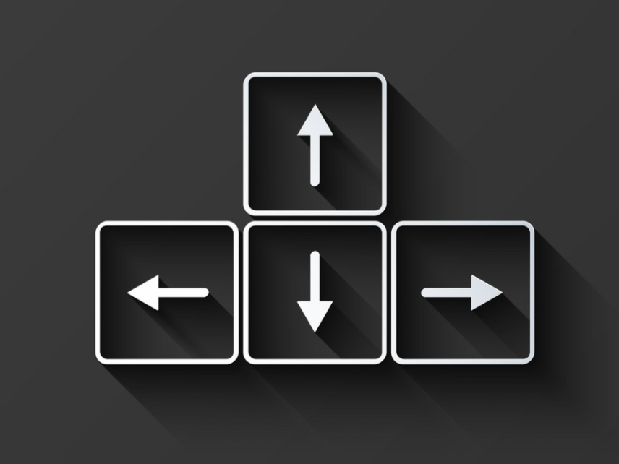
Controls
Arrow keys
Arrow keys are use for the movement of the character
<- left arrow key indicates the character to move in the left side
->right arrow key indicates the character to move in the right side.

Slide 14

W key
W- is use to perform a jump
-use to scale the terrain
-avoid enemy attacks.

Slide 15

E key
It is use to sprint. This increase the characters speed
-use to scale faster
-make longer jumps

Slide 16

R key
Use to perform an attack on the enemy
-to kill an enemy

Slide 17

F key
Use to dash
- instantaneous movement in the direction of the arrow key being use

Slide 18
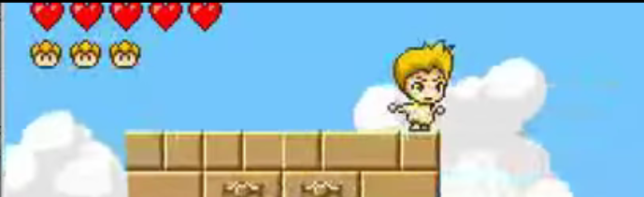
Hearts
Indicates how many hits you can take.
1 hit will reduce the heart by one
Head
Each head contains 5 hearts

Slide 19
How to finish the game
You have to clear the 3 dungeons.
After you kill the boss the game will end.

Slide 20
SIGNIFICANT CODES

Slide 21
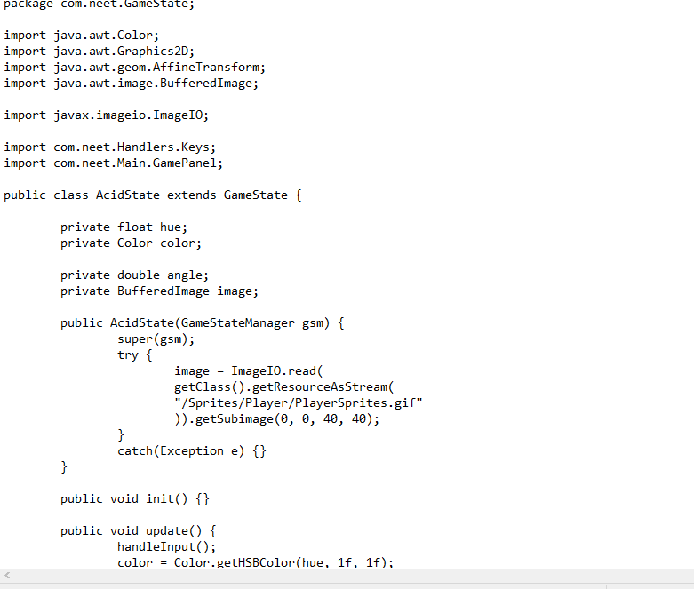
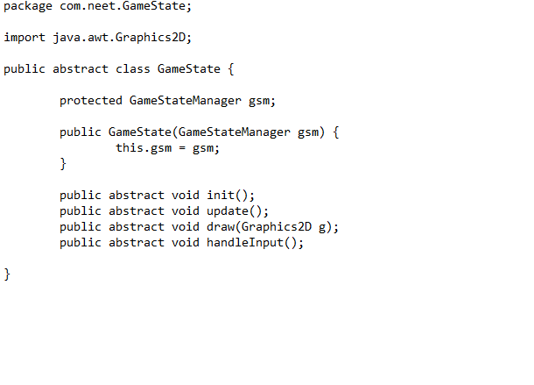
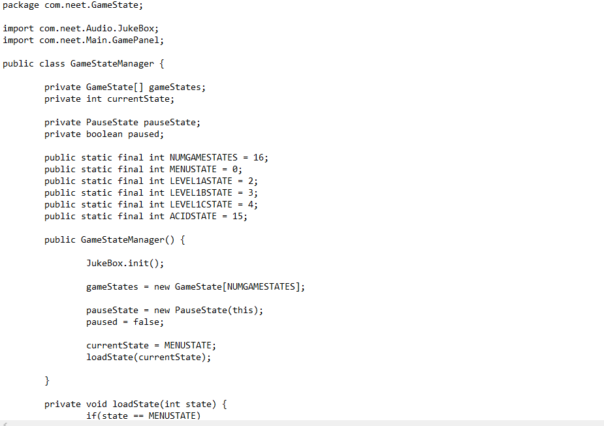
GAMESTATE

Slide 22
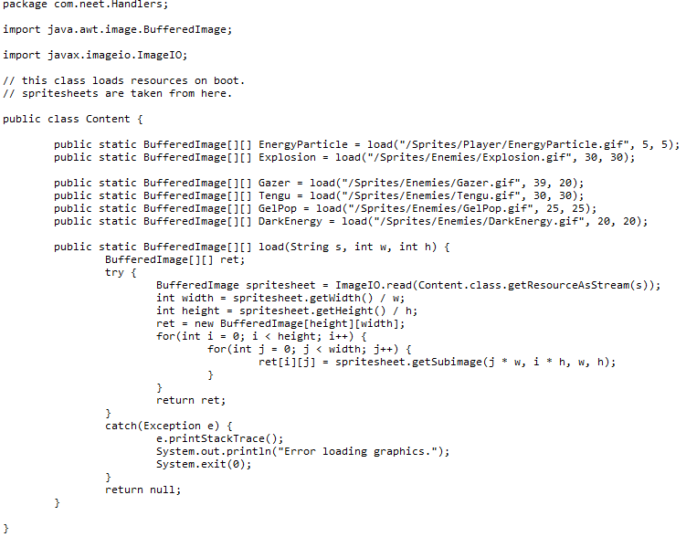
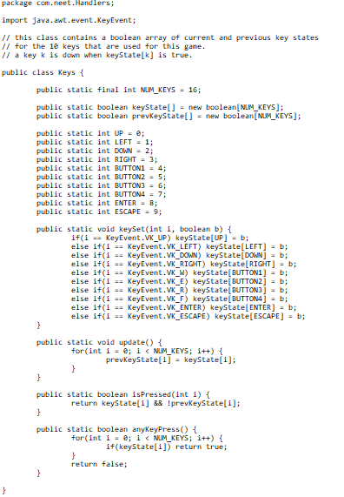
HANDLERS

Slide 23
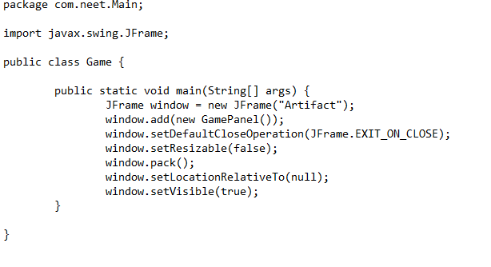
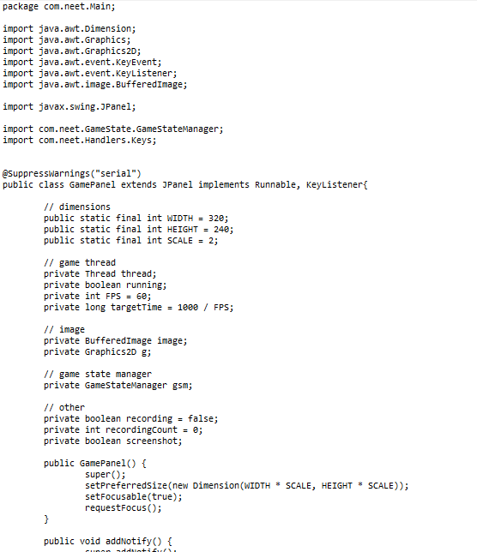
MAIN

Slide 24
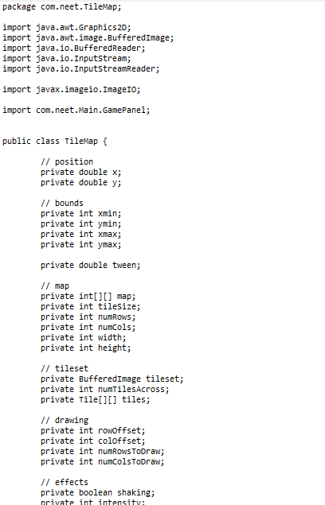
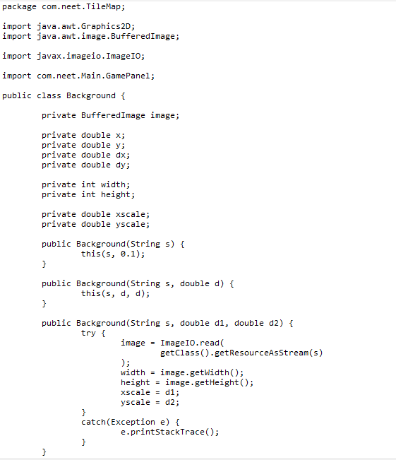
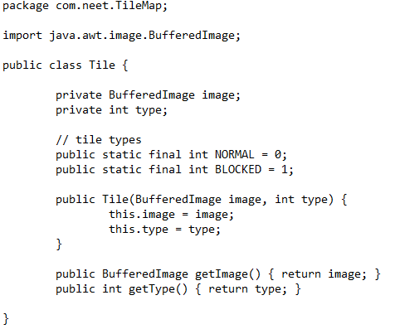
TITLE MAP

Slide 25
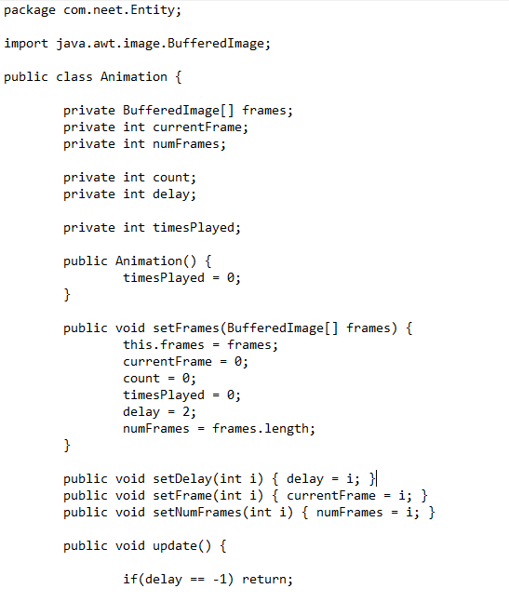
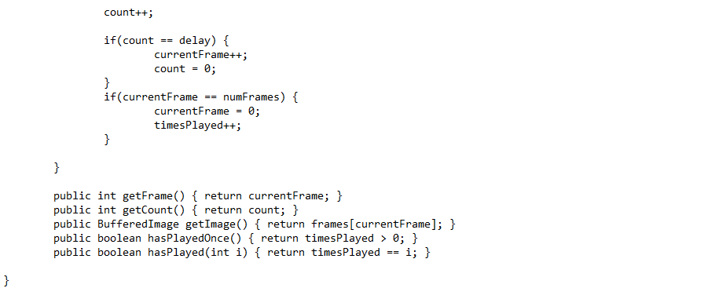
ENTITY

Slide 26
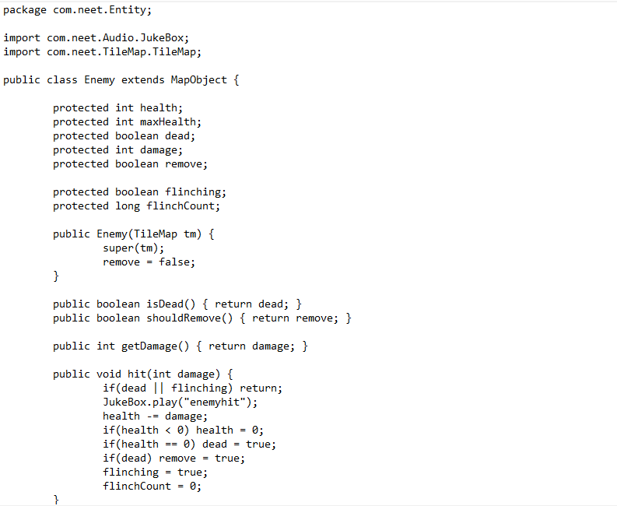
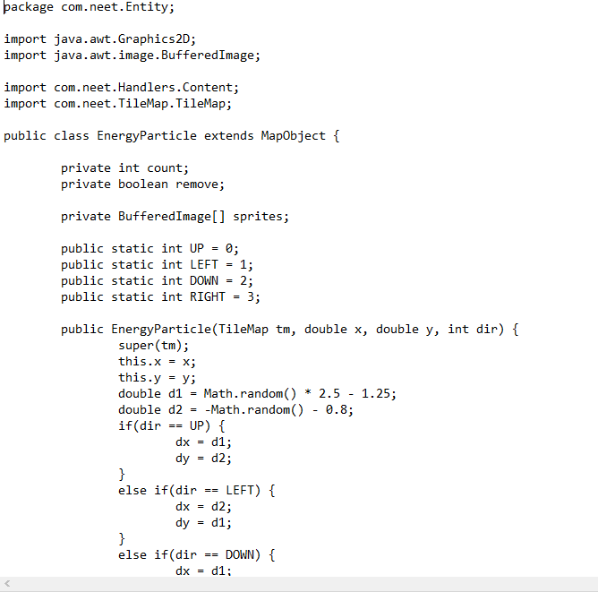
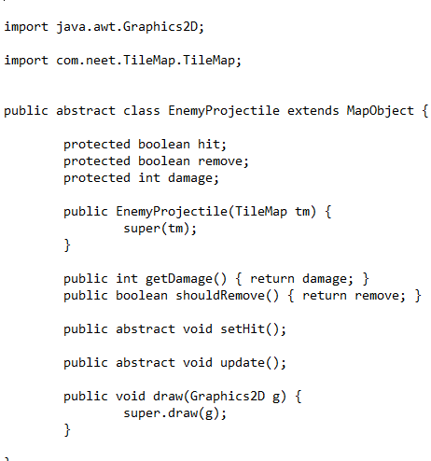

Slide 27
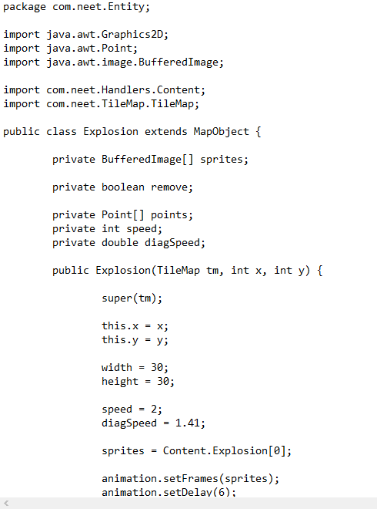
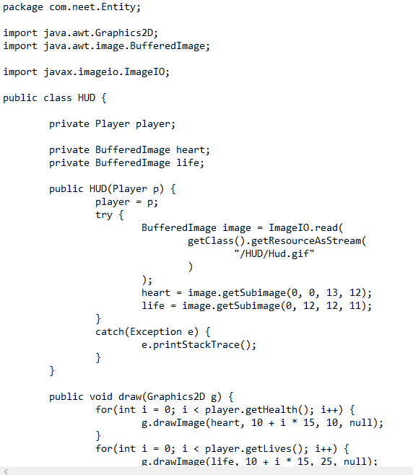
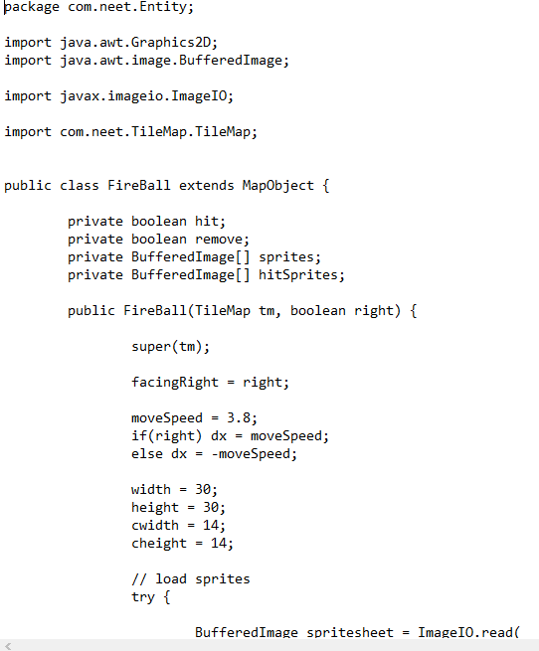

Slide 28
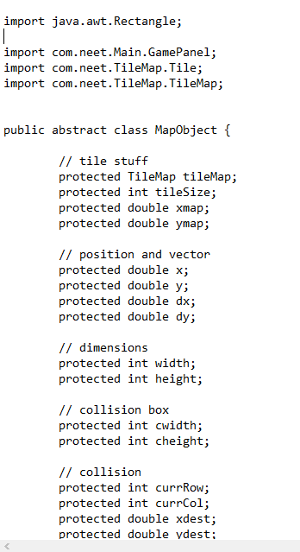
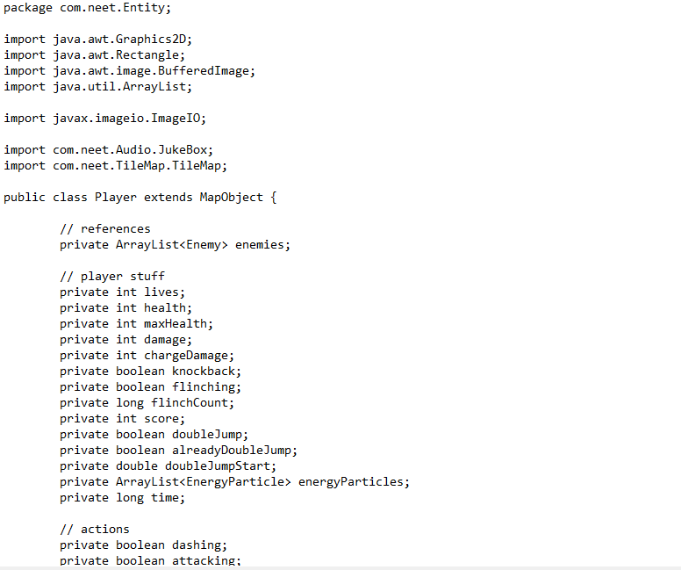
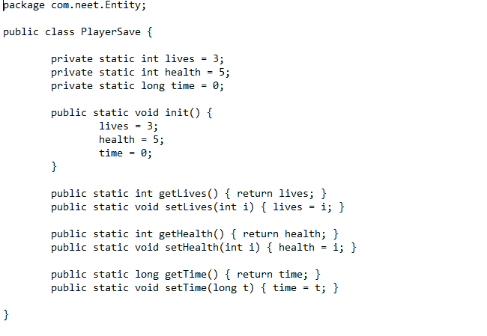

Slide 29
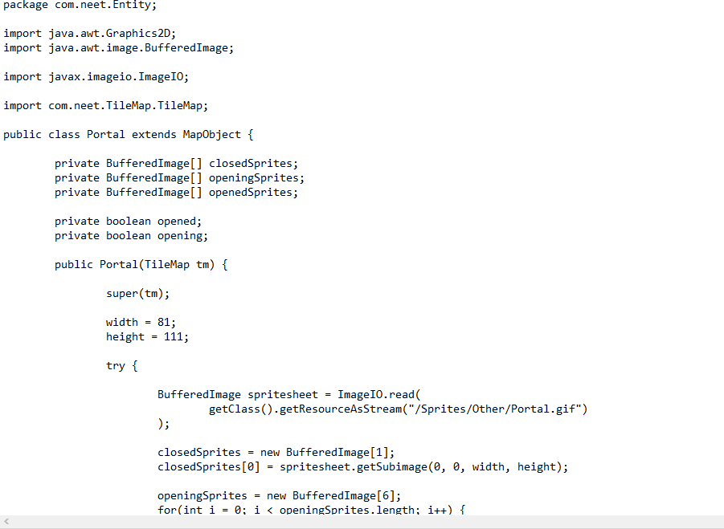
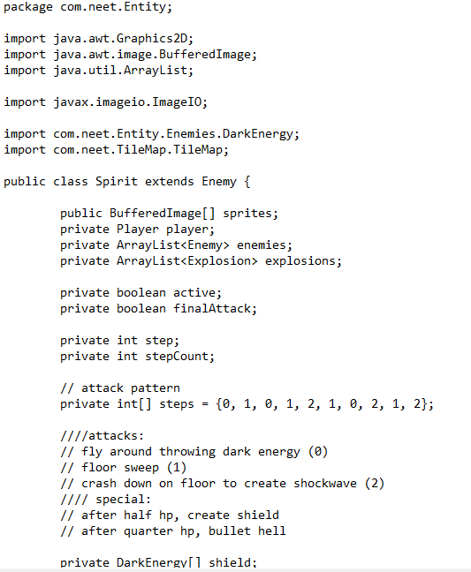

Slide 30
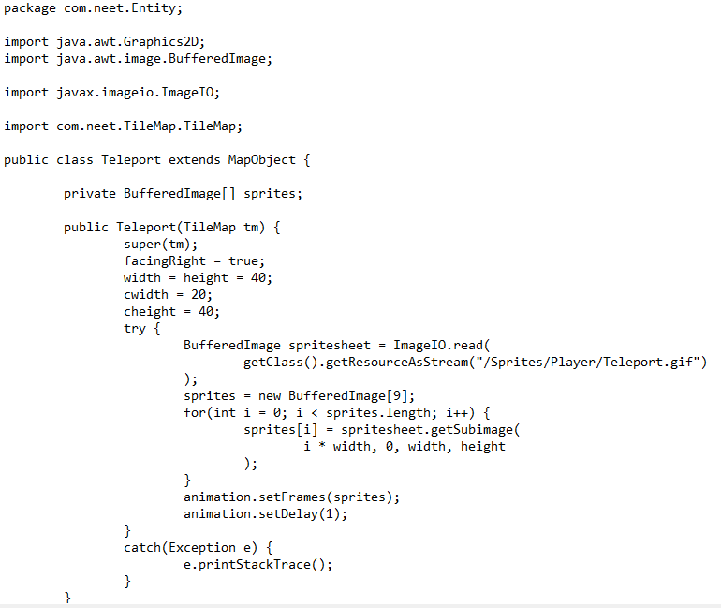
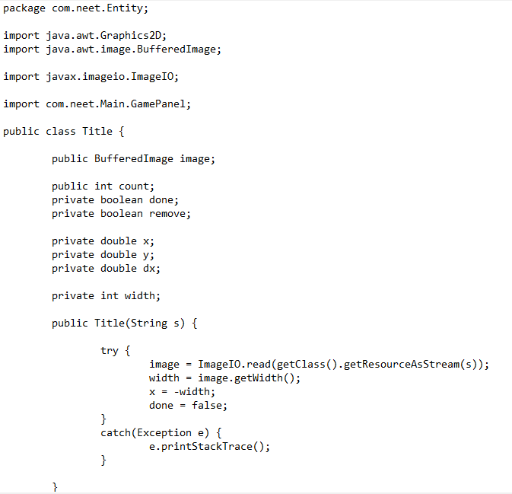

Slide 31
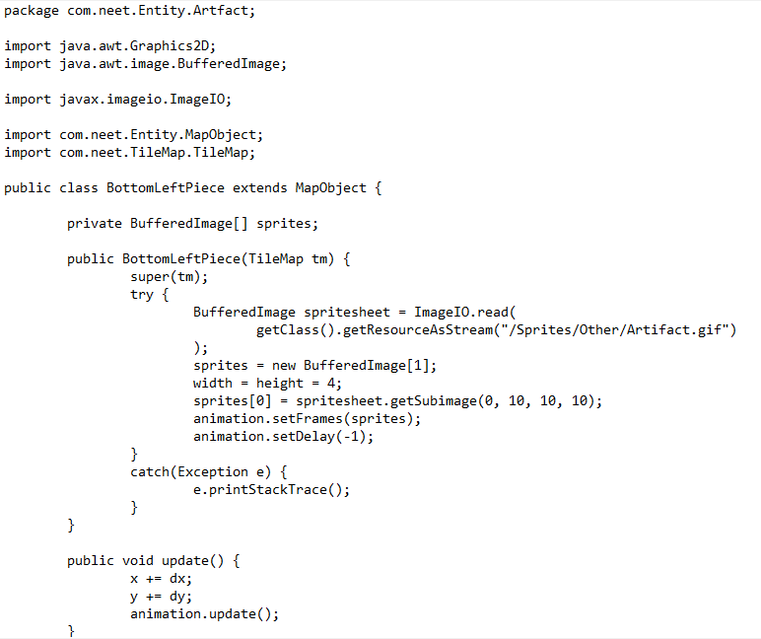
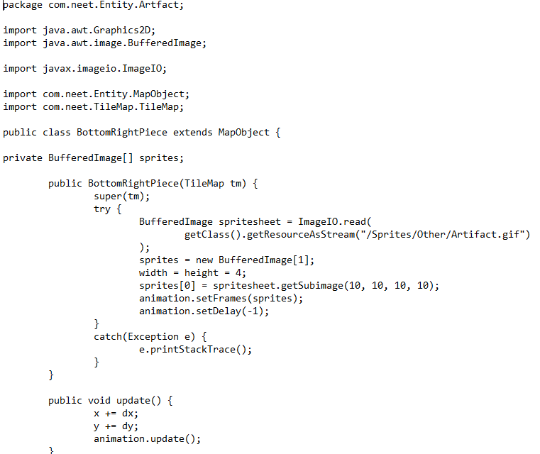
ARTFACT

Slide 32
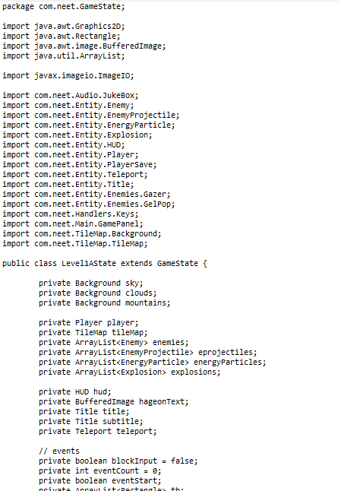
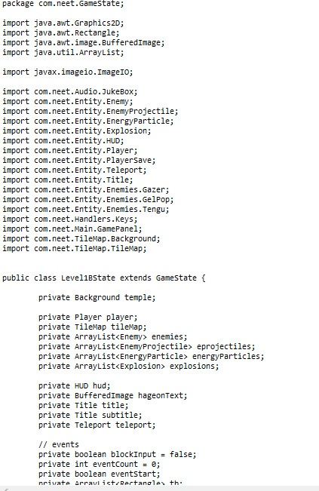
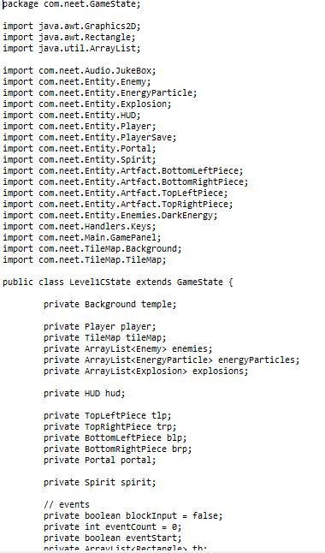

Slide 33
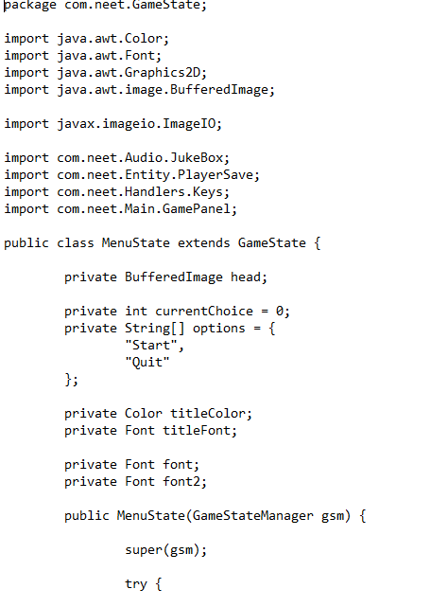
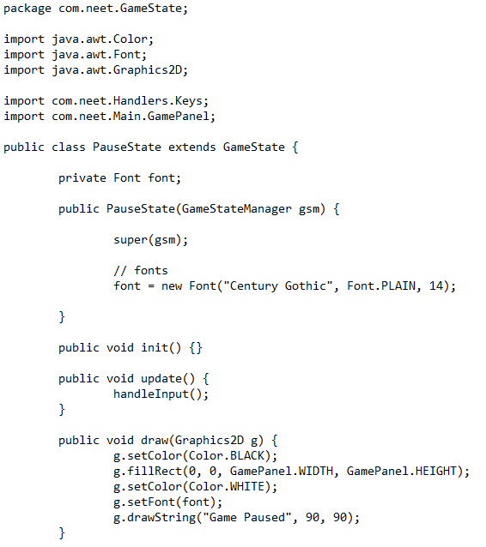

Slide 34
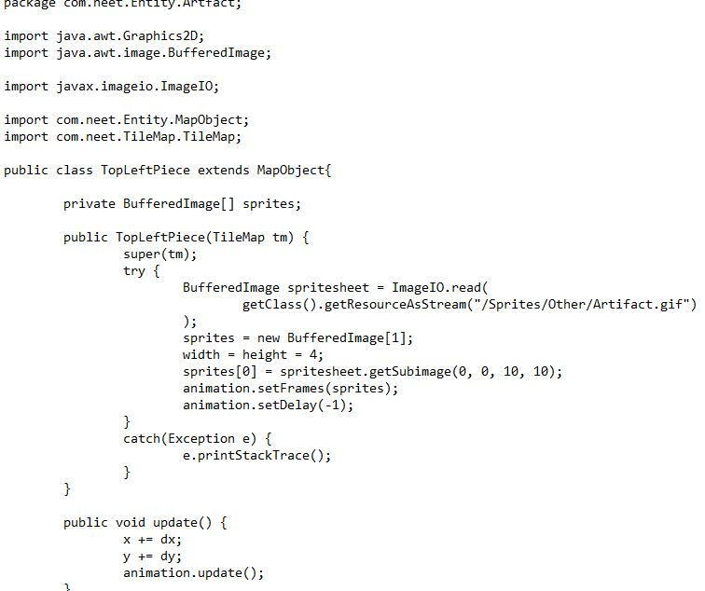
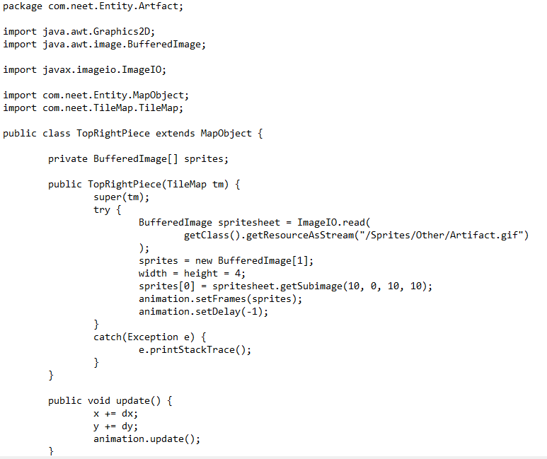

Slide 35
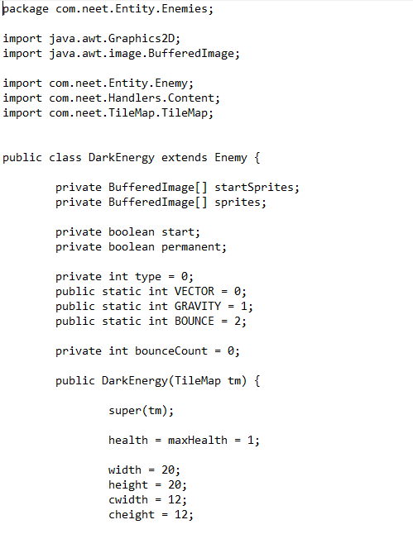
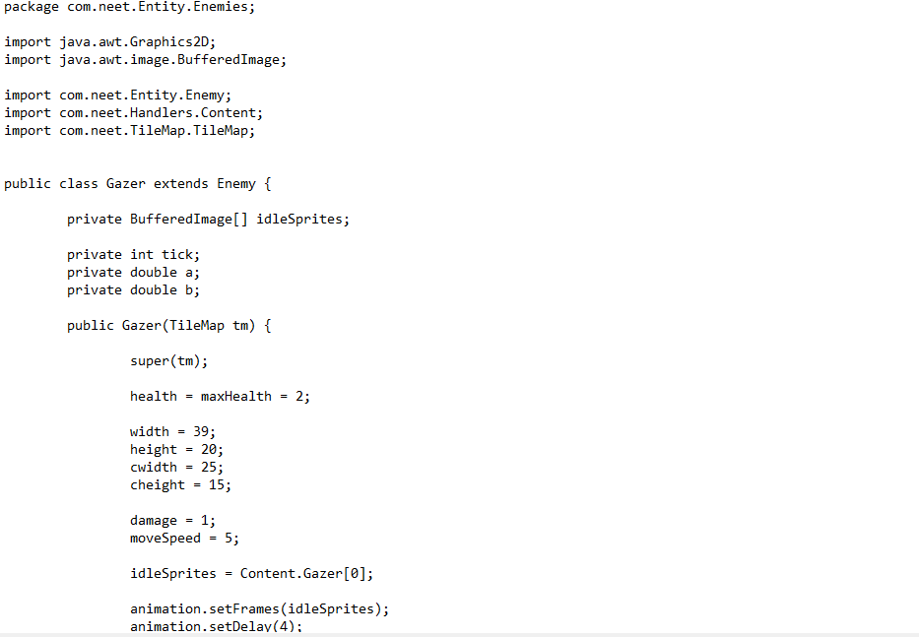
ENEMIES

Slide 36
